Slide 1
CO 2
Session no. 14

Slide 2
IPv4 ADDRESSES
An IPv4 address is a 32-bit address that uniquely and universally defines the connection of a device (for example, a computer or a router) to the Internet..
Topics discussed in this section:
Address Space Notations
Classful Addressing Classless Addressing
Network Address Translation (NAT)

Slide 3
IPv4 addressing
An IPv4 address is 32 bits long.
The IPv4 addresses are unique and universal.
The address space of IPv4 is ₂32 or 4,294,967,296.

Slide 4
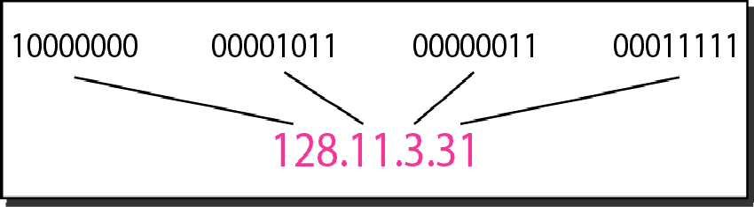
Dotted-decimal notation and binary notation for an IPv4 address

Slide 5
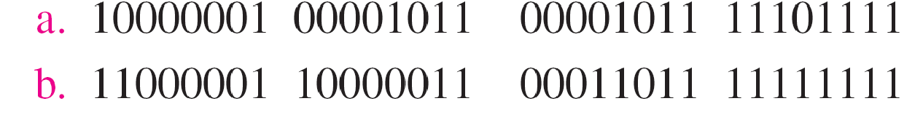
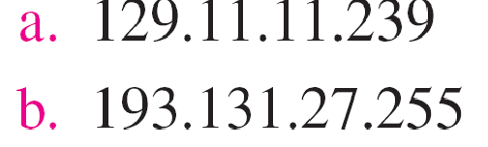
Example
Change the following IPv4 addresses from binary notation to dotted-decimal notation.
Solution
We replace each group of 8 bits with its equivalent decimal number and add dots for separation

Slide 6
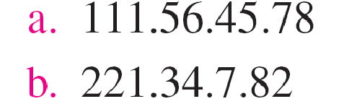
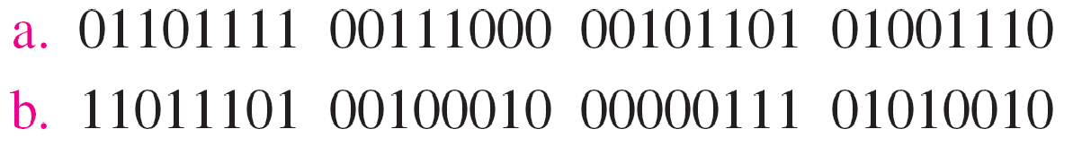
Example
Change the following IPv4 addresses from dotted-decimal notation to binary notation.
Solution
We replace each decimal
number with its binary
equivalent

Slide 7
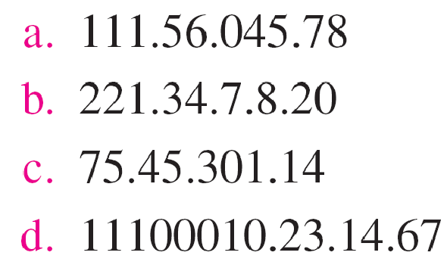
Example
Find the error, if any, in the following IPv4 addresses.
Solution
There must be no leading zero (045).
There can be no more than four numbers.
Each number needs to be less than or equal to 255.
A mixture of binary notation and dotted-decimal notation is not allowed.

Slide 8
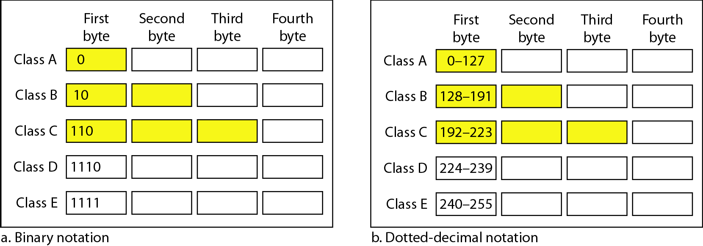
Finding the classes in binary and dotted-decimal notation
Classful addressing

Slide 9
Example
Find the class of each address.
a. 00000001 00001011 00001011 11101111
b. 11000001 10000011 00011011 11111111
c. 14.23.120.8
d. 252.5.15.111
Solution
The first bit is 0. This is a class A address.
The first 2 bits are 1; the third bit is 0. This is a class C address.
The first byte is 14; the class is A.
The first byte is 252; the class is E.

Slide 10
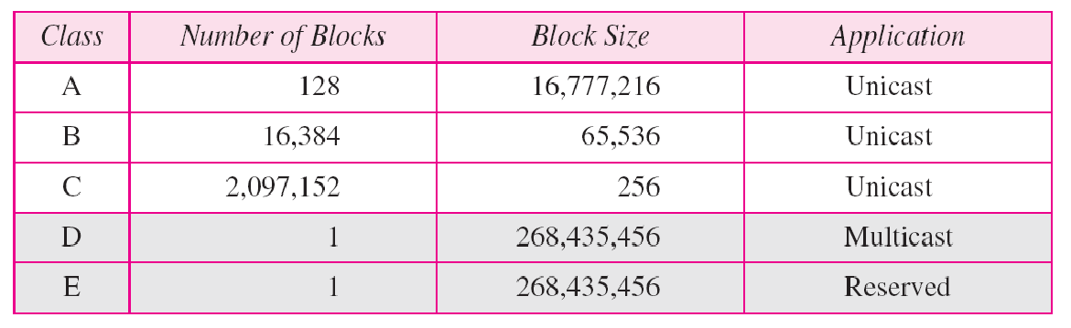
Table Number of blocks and block size in classful IPv4 addressing
POSSIBLE NET ID’S AND HOST ID’S

Slide 11
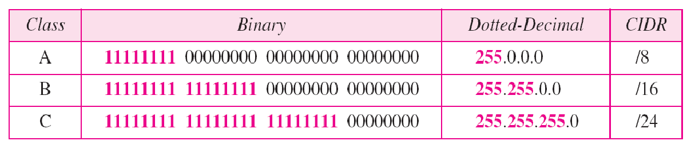
Table Default masks for classful addressing
MASK

Slide 12

Note
Classful addressing, which is almost obsolete, is replaced with classless addressing.

Slide 13
Classless addressing
RESTRICTIONS
The addresses must be contiguous.
The number of addresses must be power of 2 (16 = 2⁴)
The first address must be divisible by 16. The first address, when converted to a decimal number, is 3,440,387,360, which when divided by 16 results in 215,024,210.

Slide 14
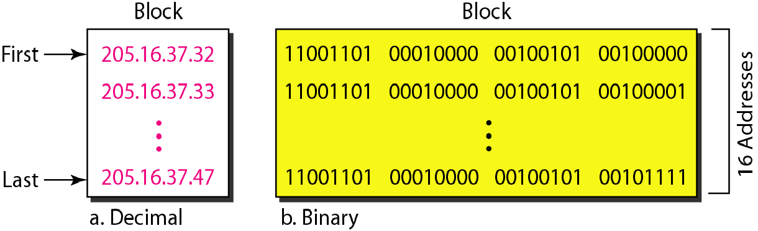
Fig. A block of 16 addresses granted to a small organization

Slide 15
In IPv4 addressing, a block of addresses can be defined as
x.y.z.t /n
in which x.y.z.t defines one of the addresses and the /n defines the mask.

Slide 16
First address
The first address in the block can be found by setting the rightmost
32 − n bits to 0s.

Slide 17
Example
A block of addresses is granted to a small organization. We know that one of the addresses is 205.16.37.39/28. What is the first address in the block?
Solution
The binary representation of the given address is
11001101 00010000 00100101 00100111
If we set 32−28 rightmost bits to 0, we get
11001101 00010000 00100101 0010000
or 205.16.37.32.
This is actually the block shown in Figure 19.3.

Slide 18
Last address
The last address in the block can be found by setting the rightmost
32 − n bits to 1s.

Slide 19
Example
Find the last address for the block in Example 19.6.
Solution
The binary representation of the given address is 11001101 00010000 00100101 00100111
If we set 32 − 28 rightmost bits to 1, we get 11001101 00010000 00100101 00101111
or 205.16.37.47
This is actually the block shown in Figure 19.3.

Slide 20
Number of addresses in a block
The number of addresses in the block
can be found by using the formula ₂32−n.

Slide 21
example
Find the number of addresses in Example 19.6.
Solution
The value of n is 28, which means
that
number
of addresses is 2 ³²⁻²⁸ or 16.

Slide 22
Example
Another way to find the first address, the last address, and the number of addresses is to represent the mask as a 32- bit binary (or 8-digit hexadecimal) number. This is particularly useful when we are writing a program to find these pieces of information. In Example 19.5 the /28 can be represented as
11111111 11111111 11111111 11110000
(twenty-eight 1s and four 0s).
Find
The first address
The last address
The number of addresses.

Slide 23
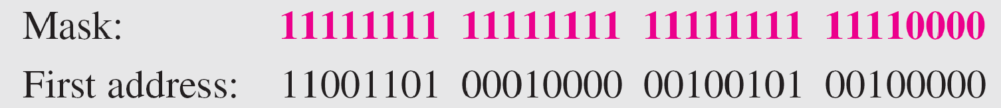
Example (continued)
Solution
a. The first address can be found by ANDing the given addresses with the mask. ANDing here is done bit by bit. The result of ANDing 2 bits is 1 if both bits are 1s; the result is 0 otherwise.

Slide 24
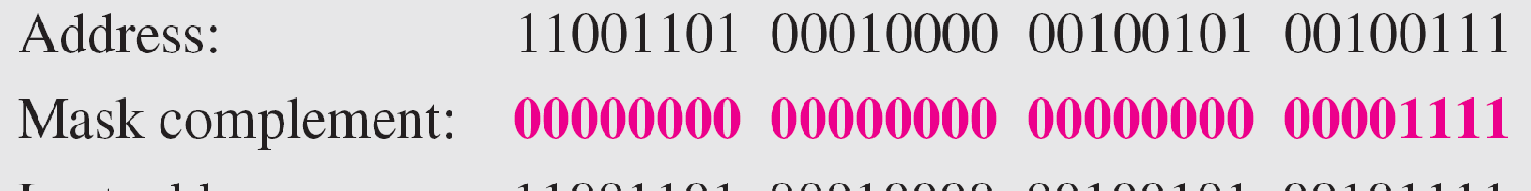
Example (continued)
b. The last address can be found by ORing the given addresses with the complement of the mask. ORing here is done bit by bit. The result of ORing 2 bits is 0 if both bits are 0s; the result is 1 otherwise. The complement of a number is found by changing each 1 to 0 and each 0 to 1.

Slide 25
Example (continued)
c. The number of addresses can be found by complementing the mask, interpreting it as a decimal number, and adding 1 to it.

Slide 26
The first address in a block is normally not assigned to any device; it is used as the network address that represents the organization
to the rest of the world.

